Slide 1
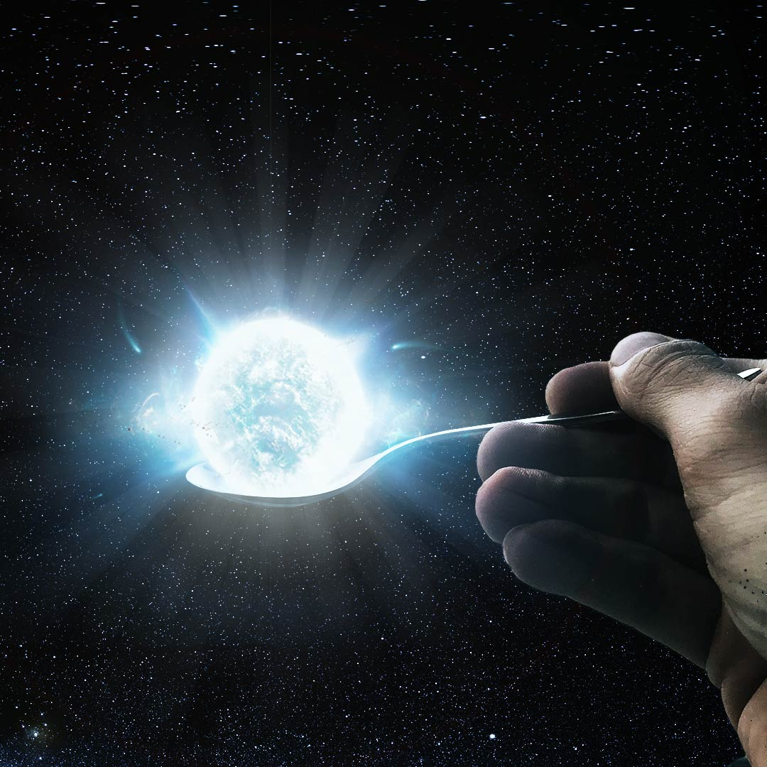
Neutron_Stars
Solving structure equations for a neutron star both in the Newtonian and the GR case
Luca Bianchi, December 2021

Slide 2
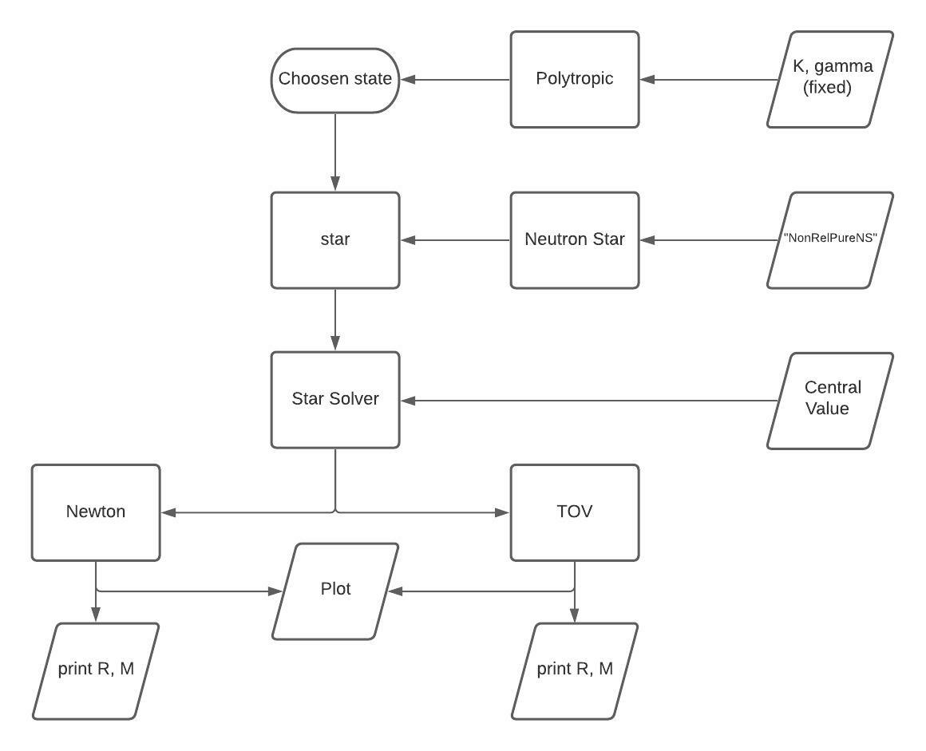
NON RELATIVISTIC PURE NEUTRON STAR MAIN

Slide 3
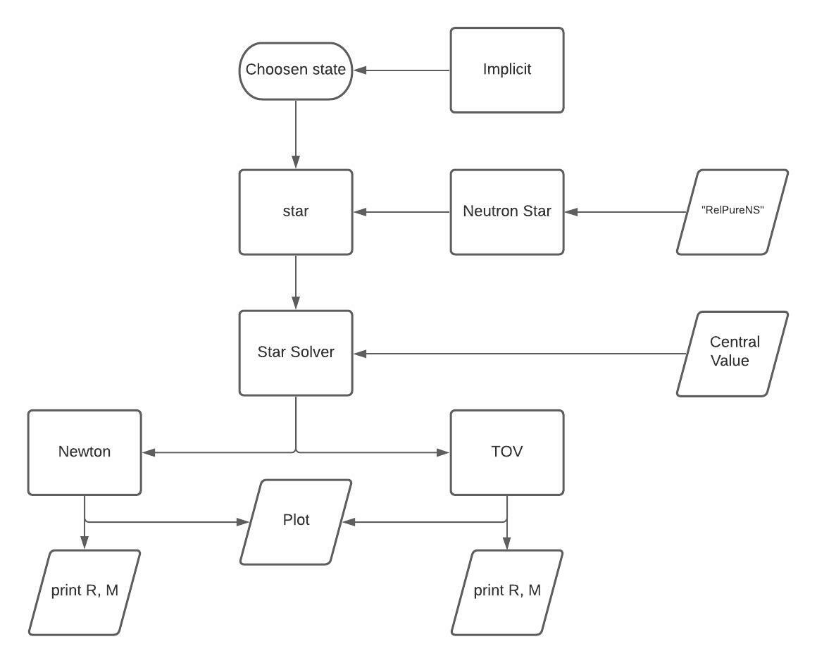
RELATIVISTIC PURE NEUTRON STAR MAIN

Slide 4
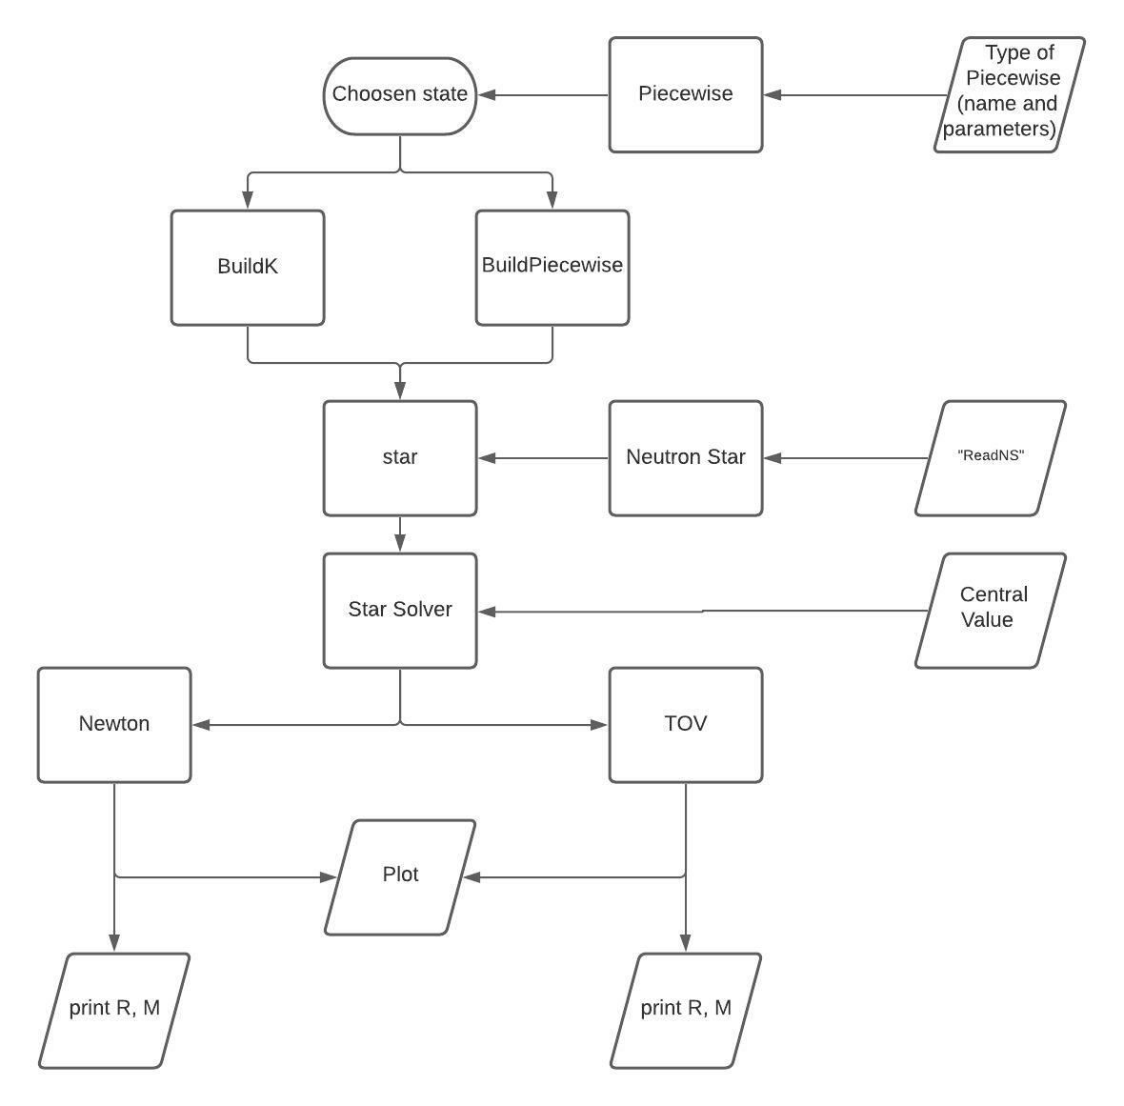
READ NON PURE NEUTRON STAR MAIN

Slide 5
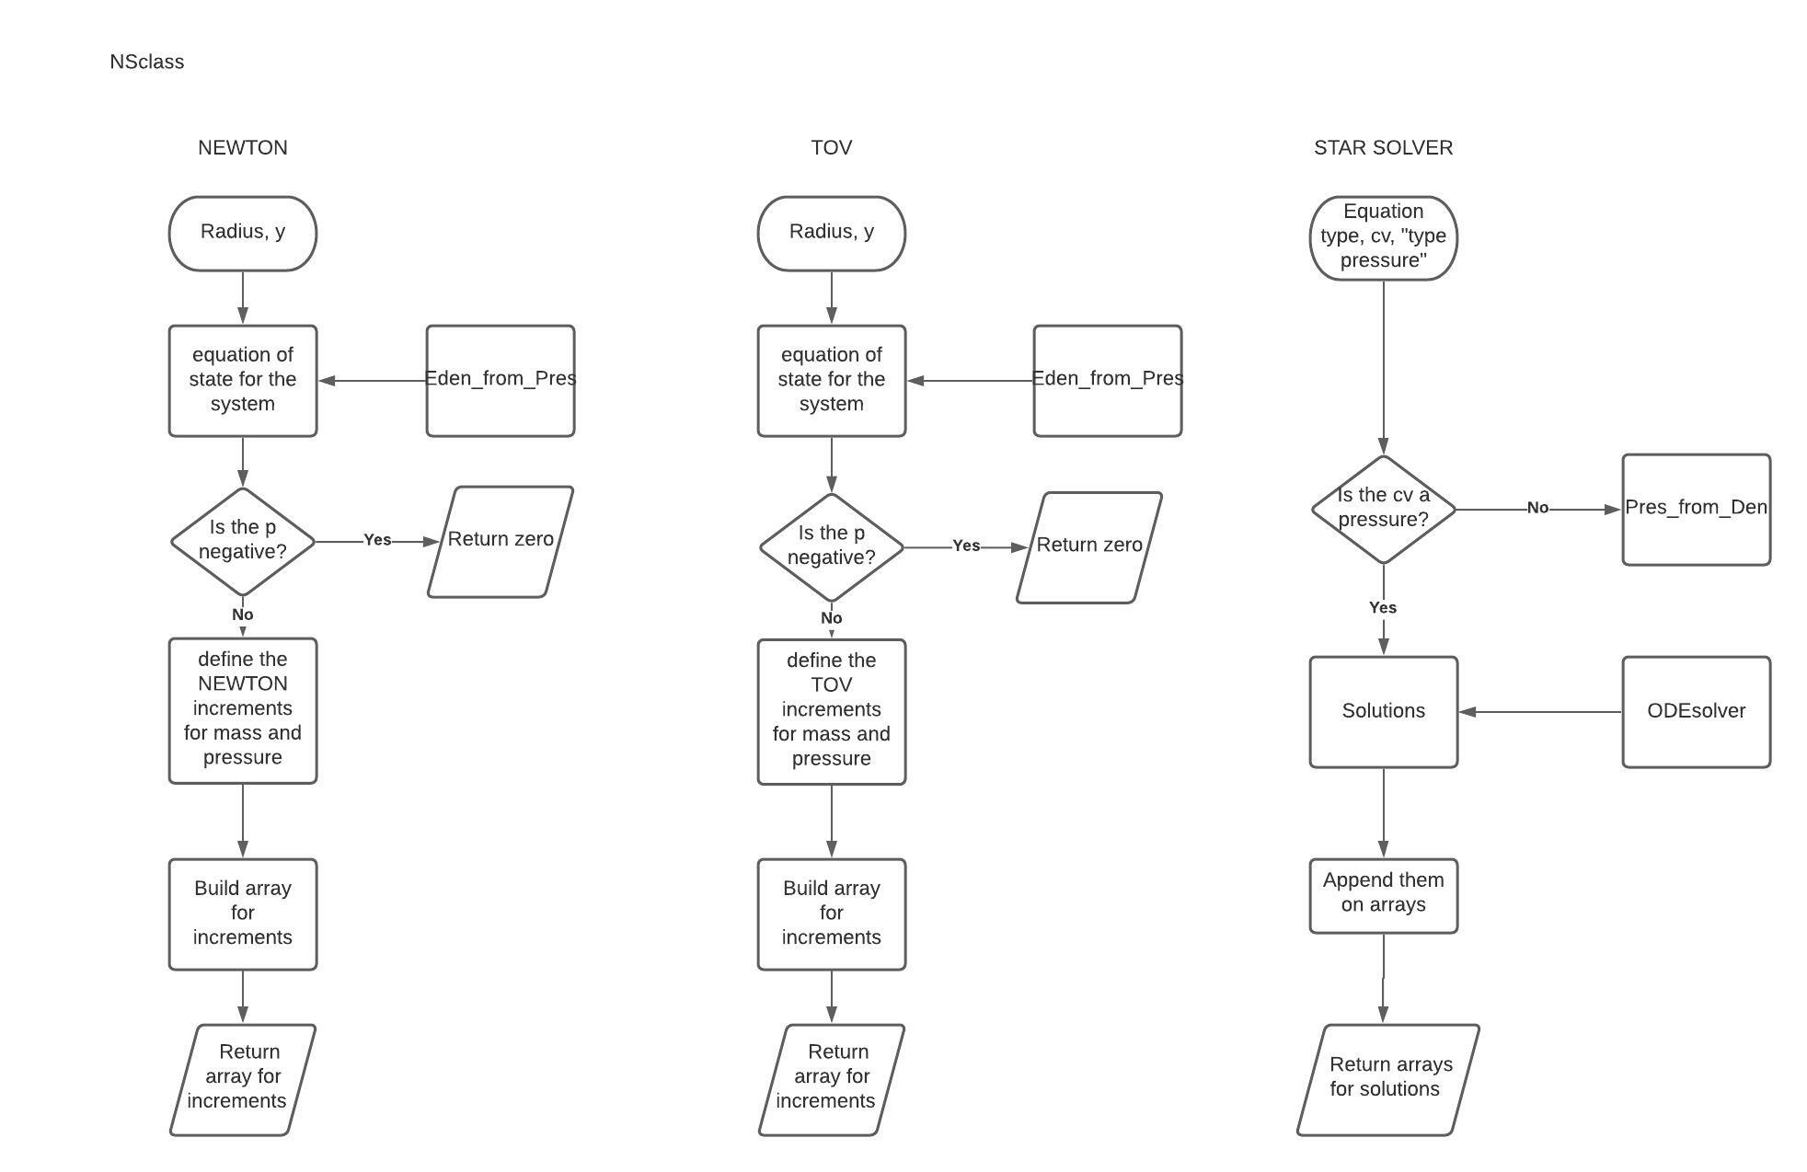
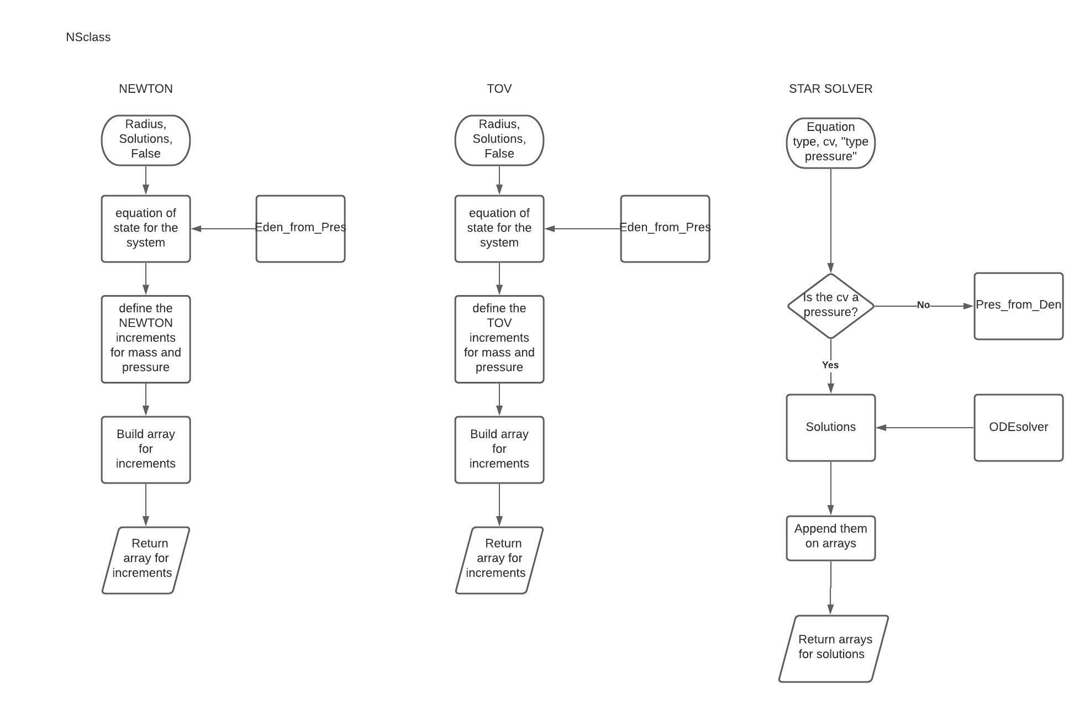
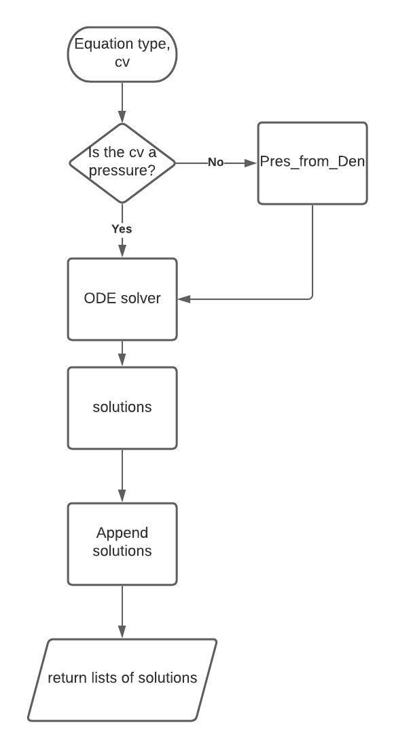
y
y

Slide 6
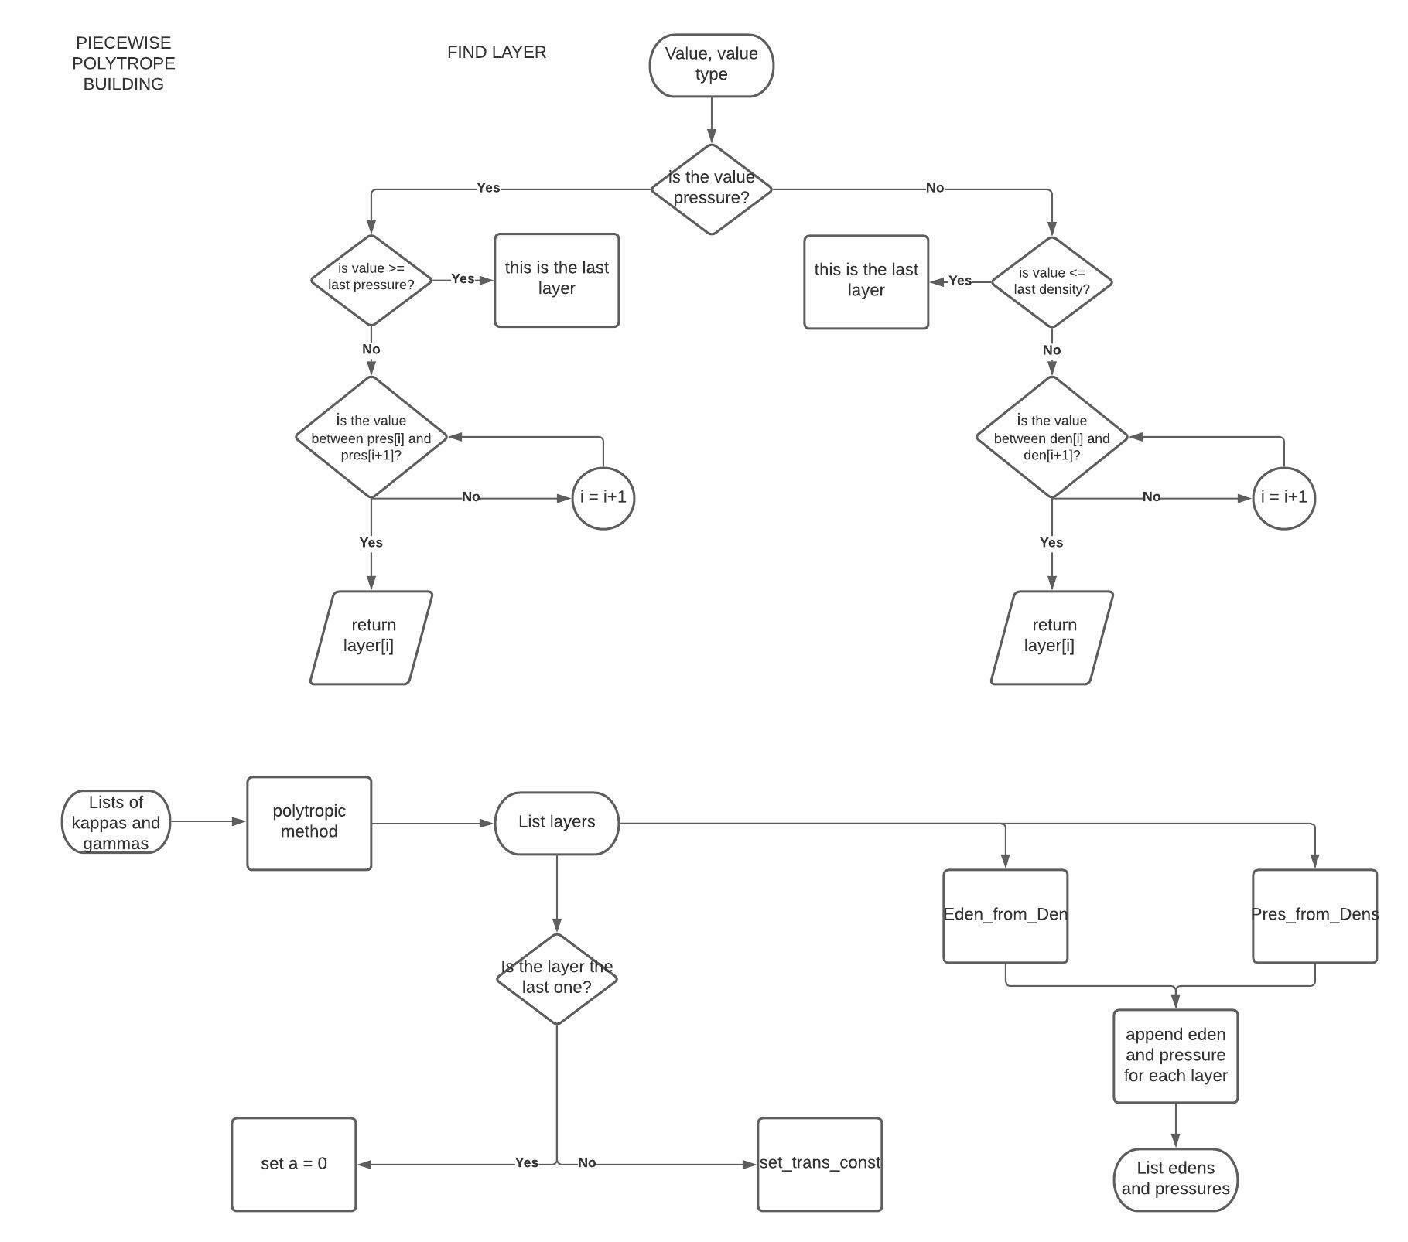
Return this layer
Return this layer

Slide 7
